Slide 1
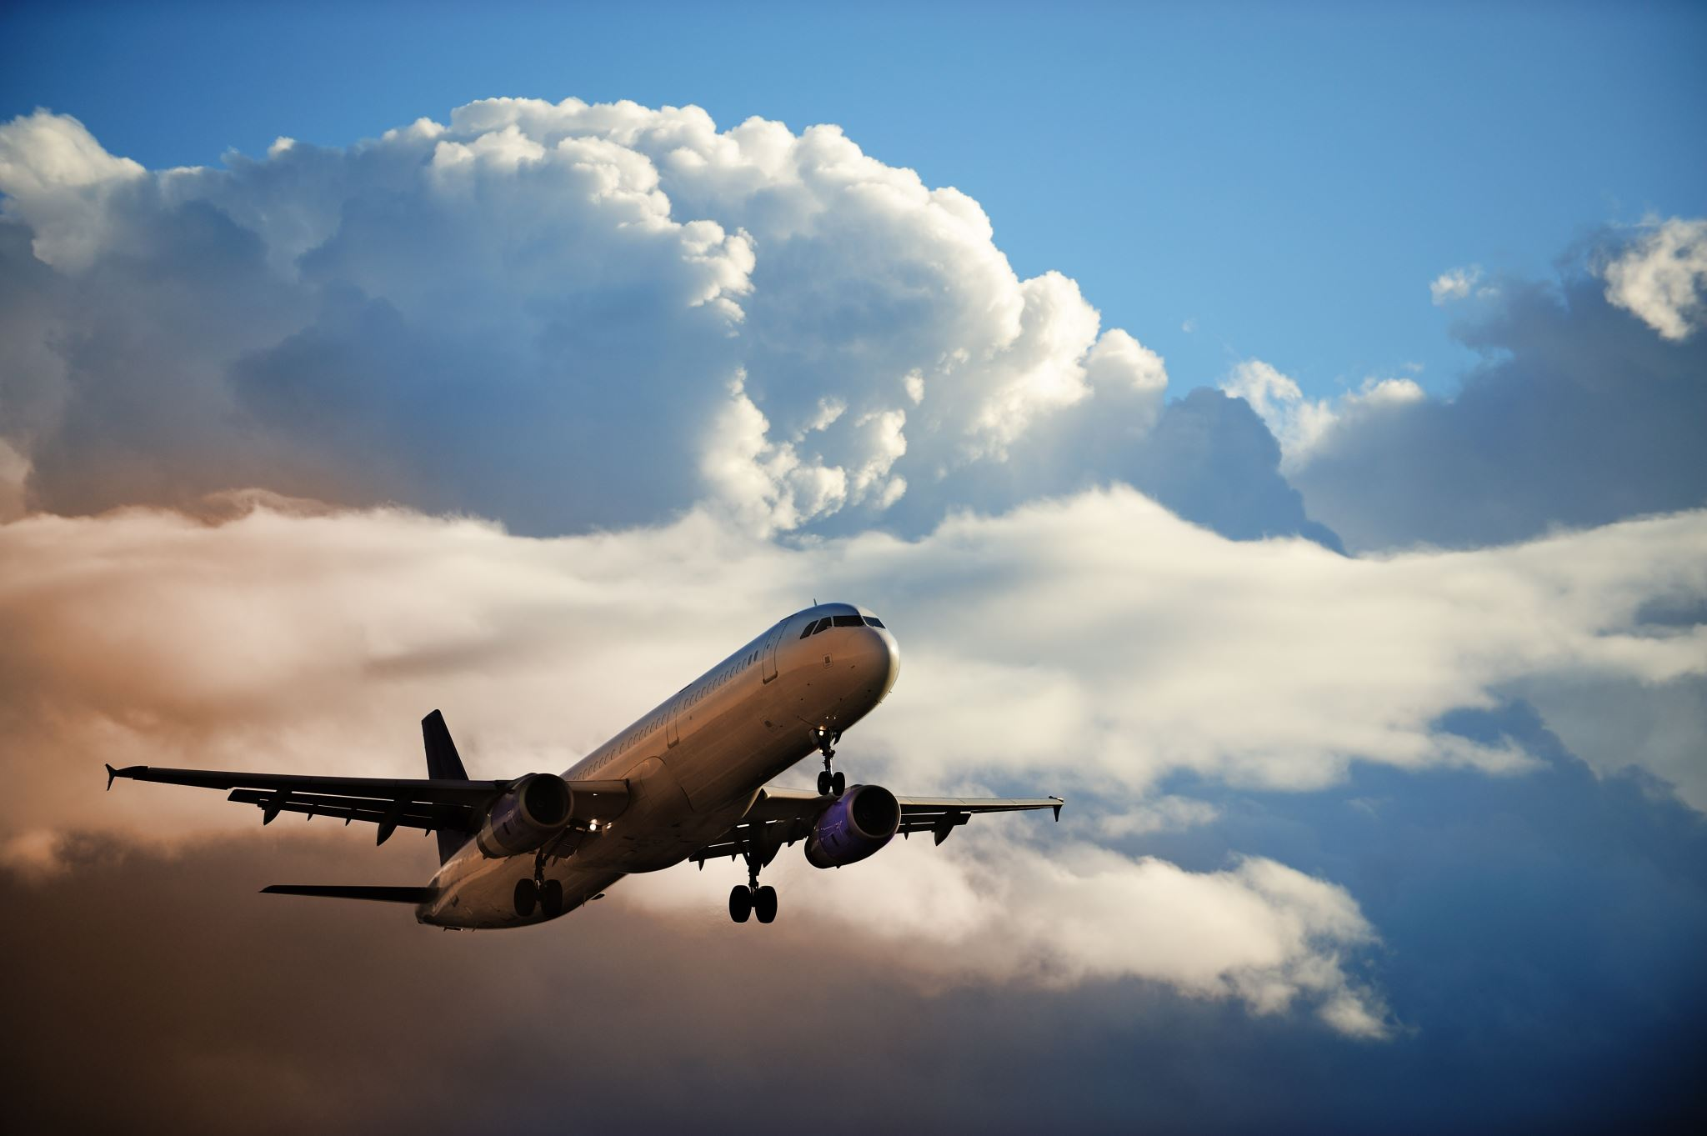
Group Project Part 1
Presented By:
Dipen Patel
Mahesh Kate
Mohammed Sahil Fnu
Karan Gaikwad
Sri Ram Fnu

Slide 2
1995
Presented by
SHRI RAM, FNU

Slide 3
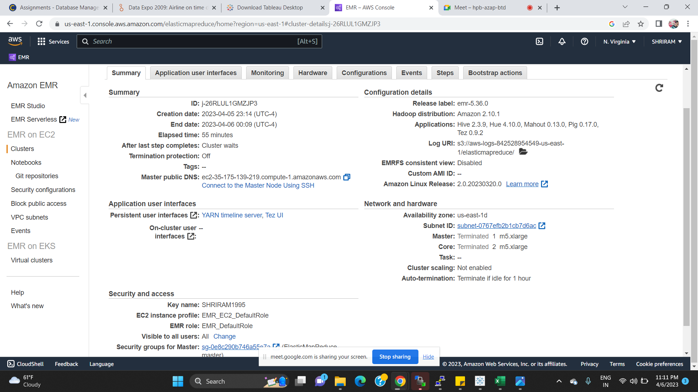
AWS Cluster Summary

Slide 4
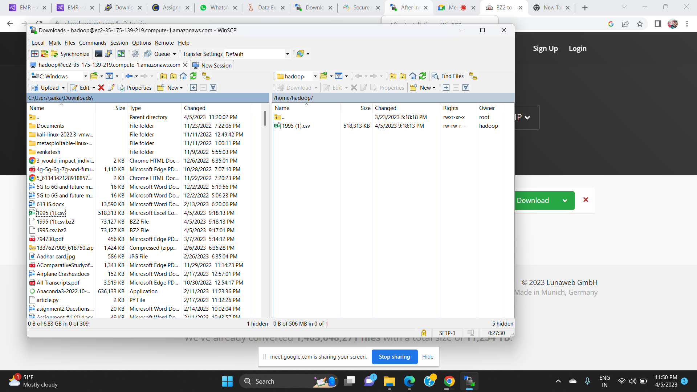
Data Loading using WINSCP

Slide 5
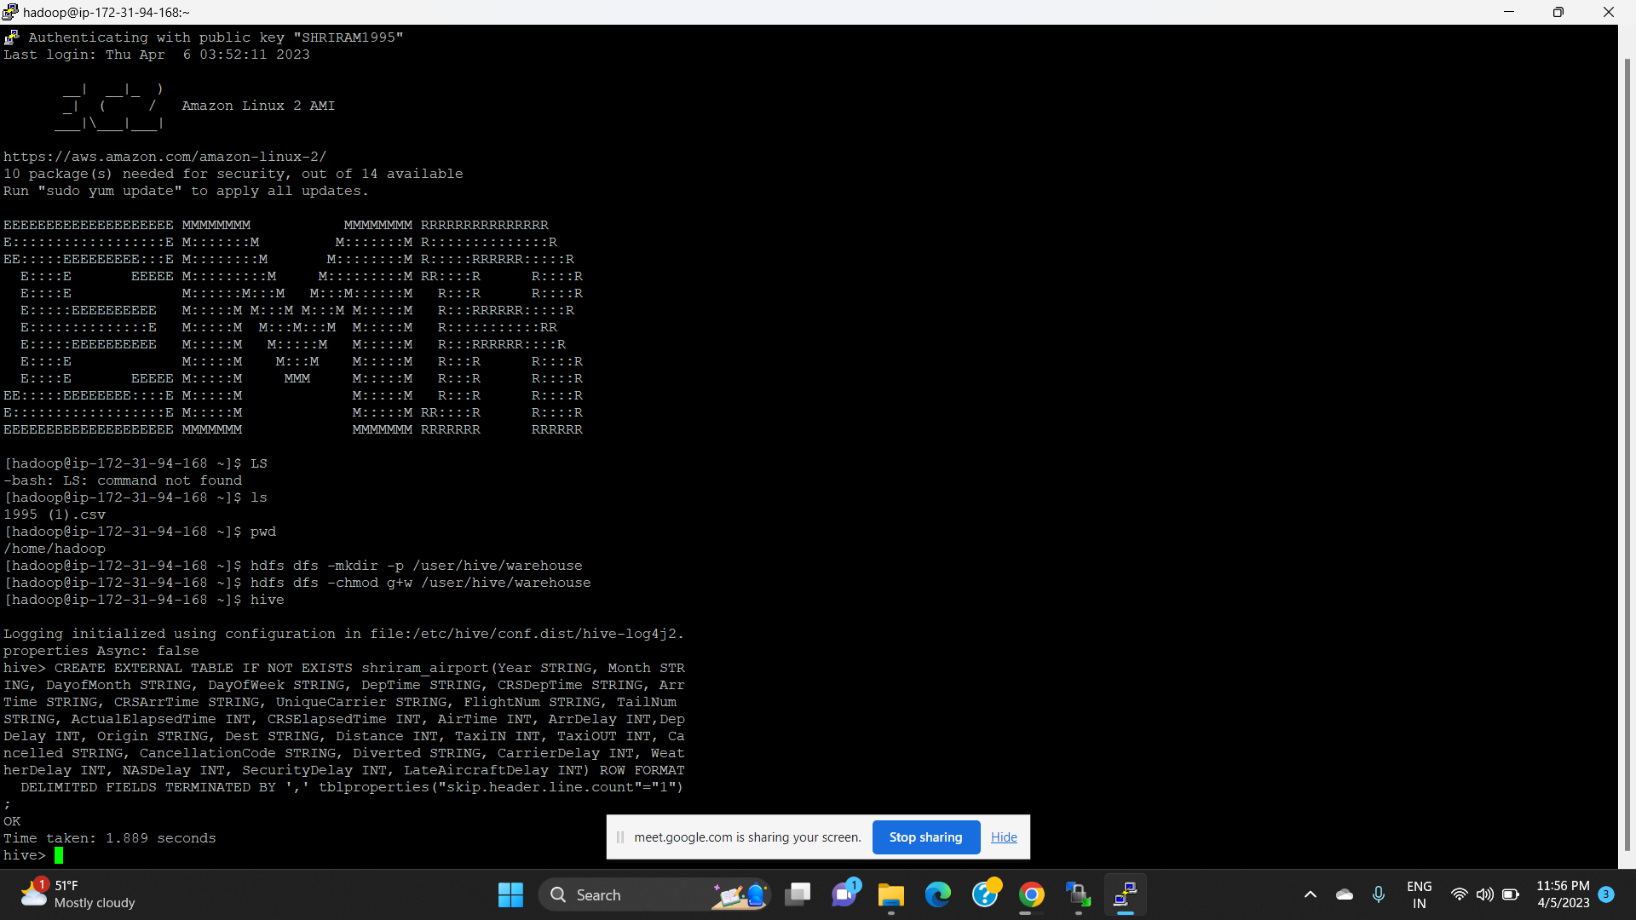
Hadoop Connection using Putty

Slide 6
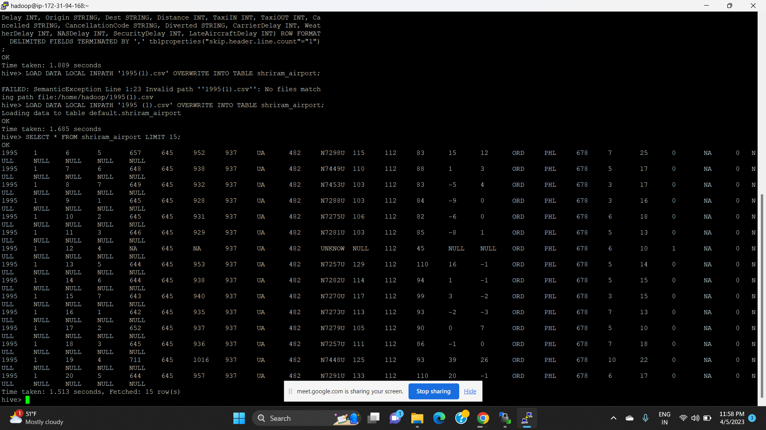
Loaded Data

Slide 7
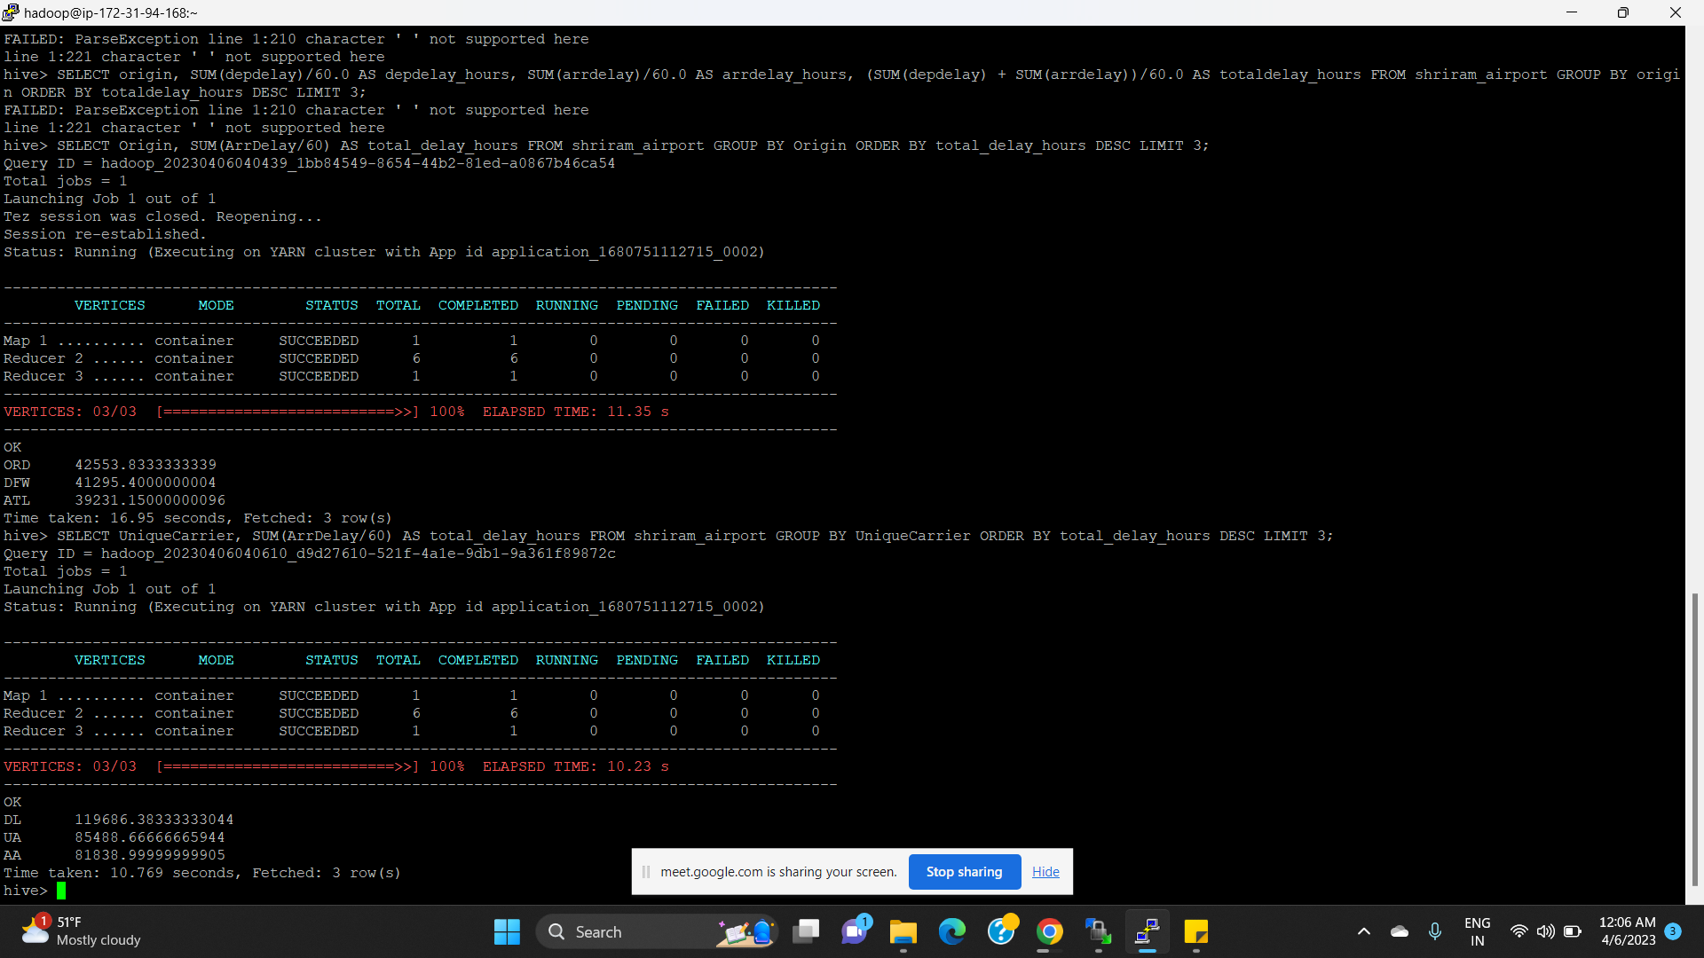
Case:1: Determine the three airports with the highest delay time

Slide 8
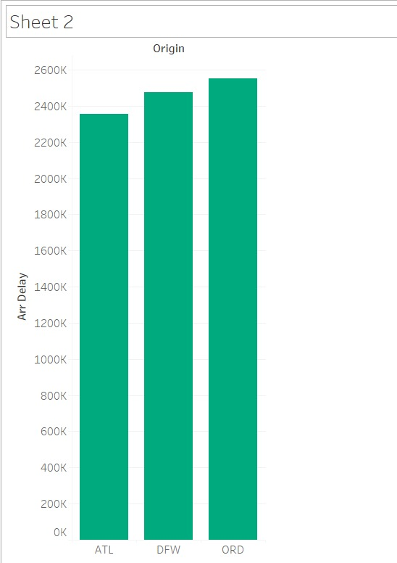
Visualization showing three airports with the highest delay time

Slide 9
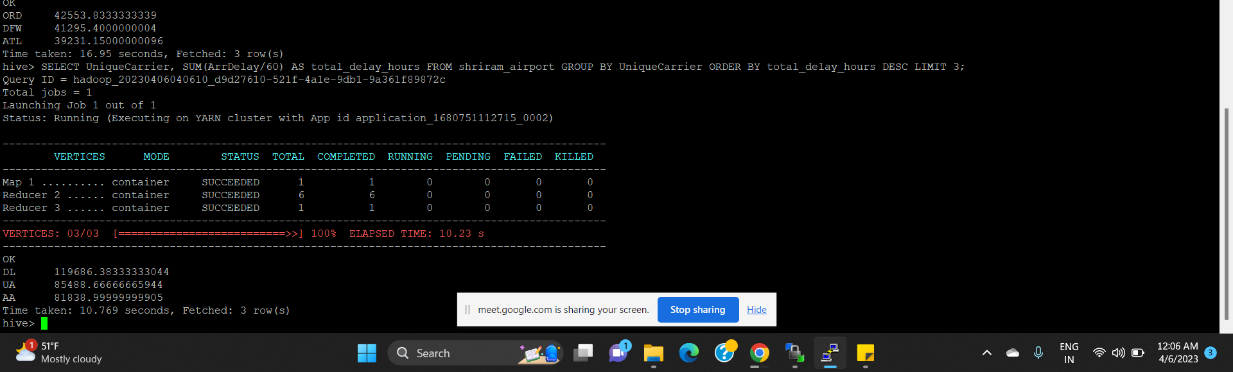
Case 2: Determine the three carriers with the highest delay time
The three carriers with the highest delay time are:
Delta (DL)
American Airlines (AA)
Southwest Airlines (WN)

Slide 10
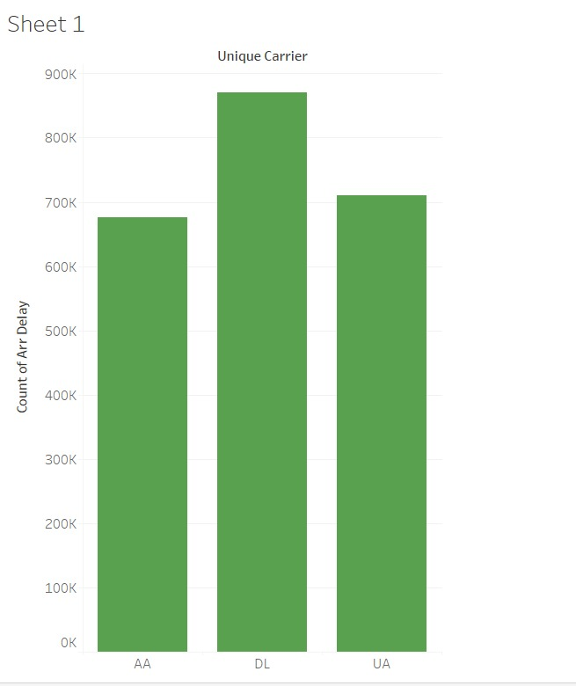
Visualization for three carriers with the highest delay time

Slide 11
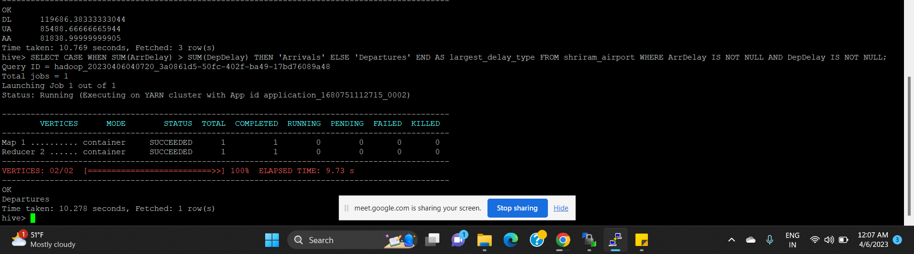
Case 3: Determine overall which type of delay (arrivals or departures) is the largest for your carriers.
All two carriers i.e
Departure delay is more then arrival delay

Slide 12
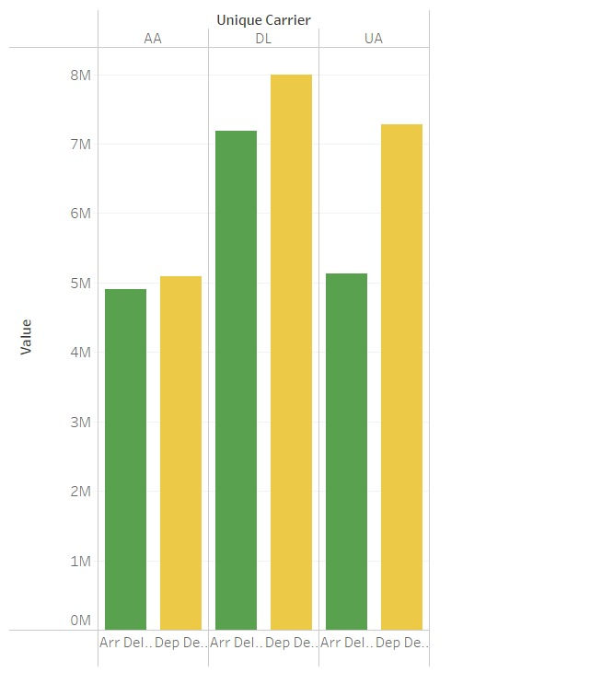
Visualization showing arrival and departure delays for the three carriers with the highest delay time

Slide 13
1998
Presented By
Fnu Mohammed Sahil

Slide 14
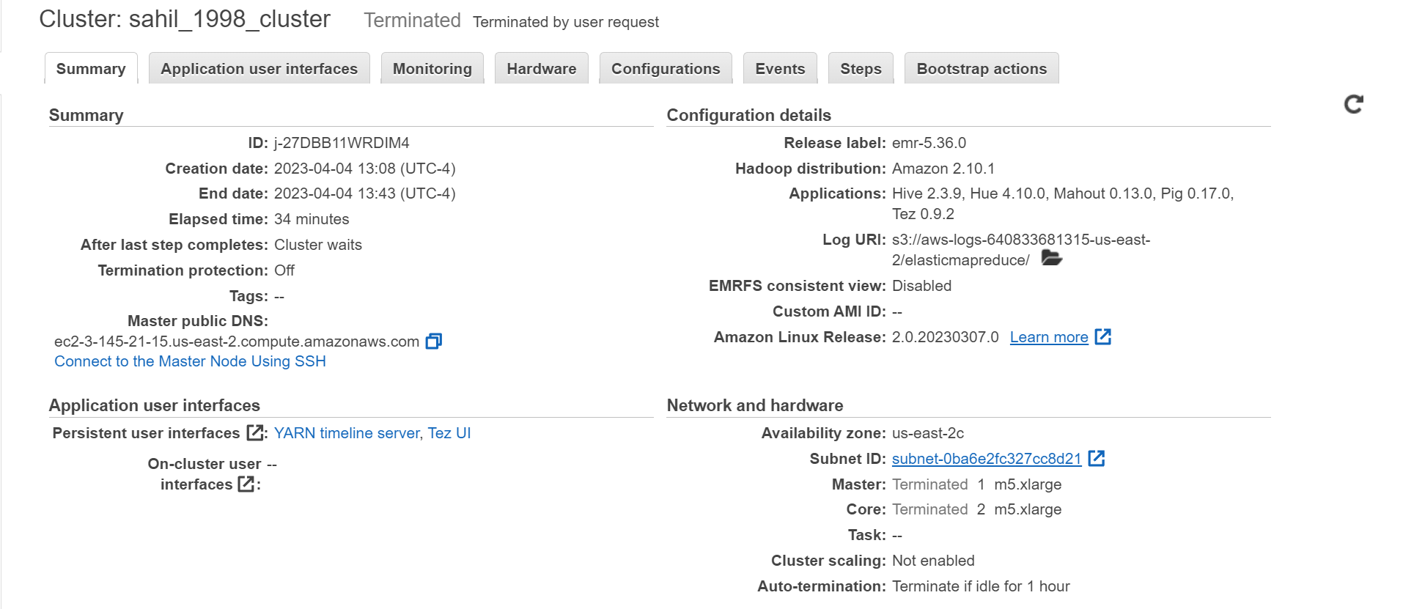
Cluster

Slide 15
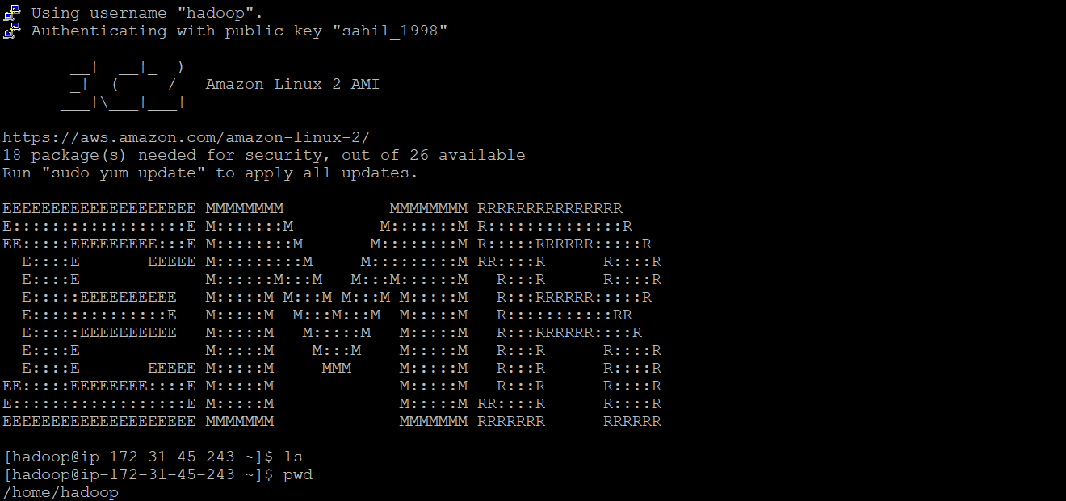
EMR HADOOP

Slide 16
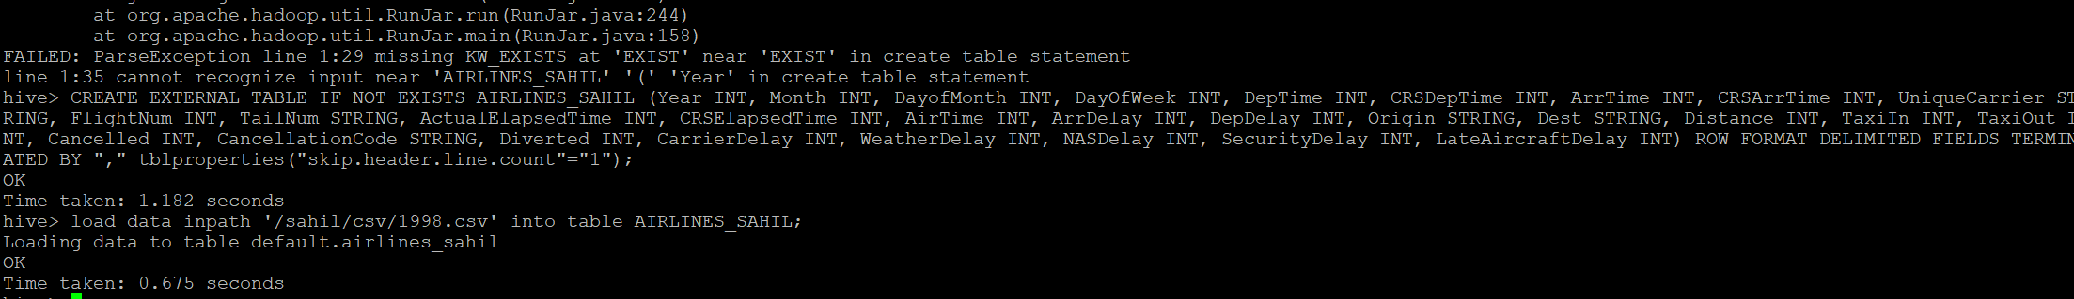
Creating the Table

Slide 17
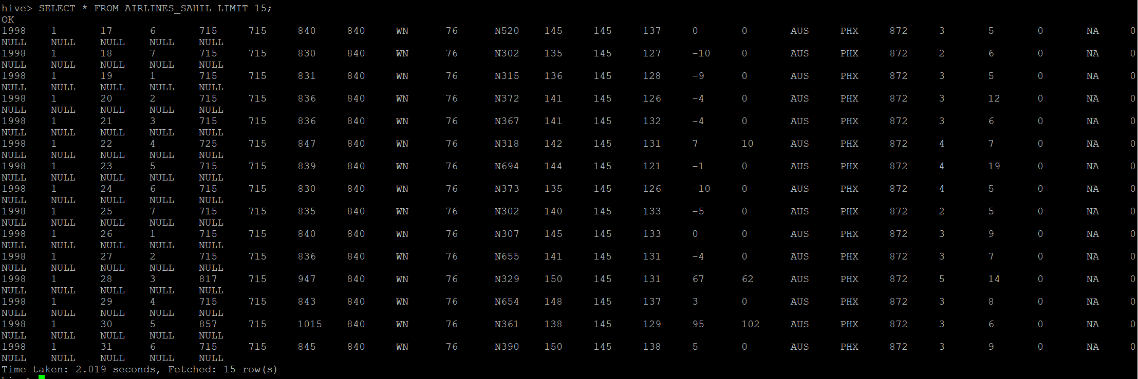
Selecting the First 15 Elements

Slide 18

Determine the three airports with the highest delay time (in hours).

Slide 19
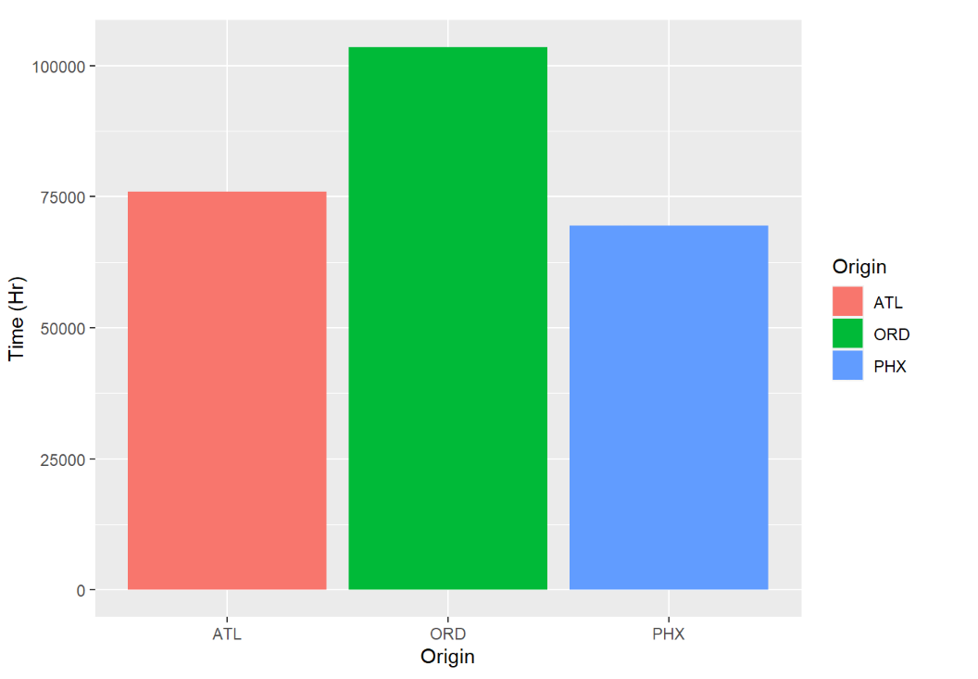
Bar Chart for Airports with Highest Delay in hours

Slide 20
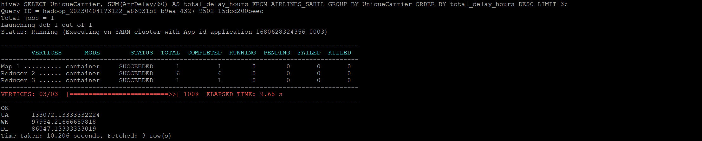
Determine the three carriers with the highest delay time (in hours).

Slide 21
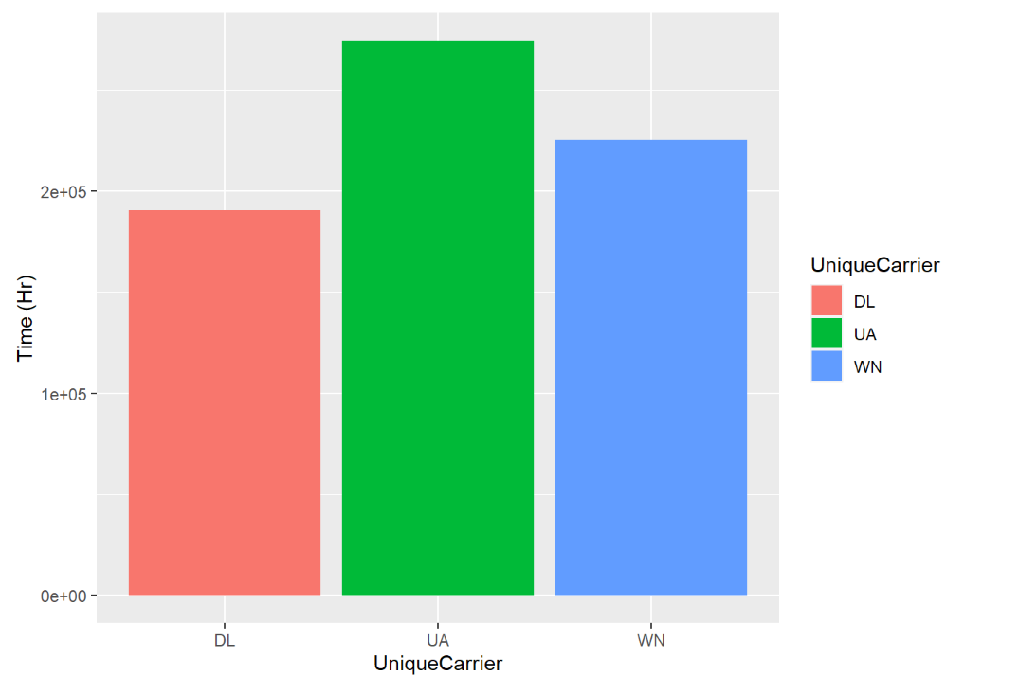
Bar Chart for the three carriers with highest delay time in hours.

Slide 22
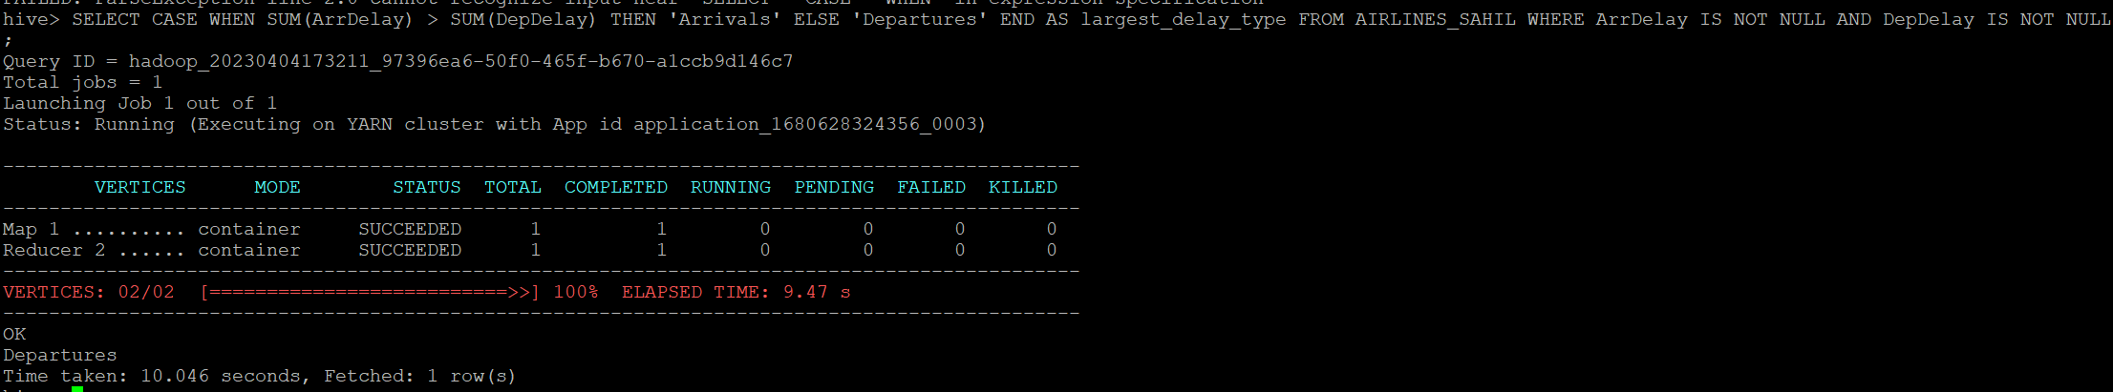
Determine overall which type of delay (arrivals or departures) is the largest for your carriers.
Departure delay is the largest for the Carriers.

Slide 23
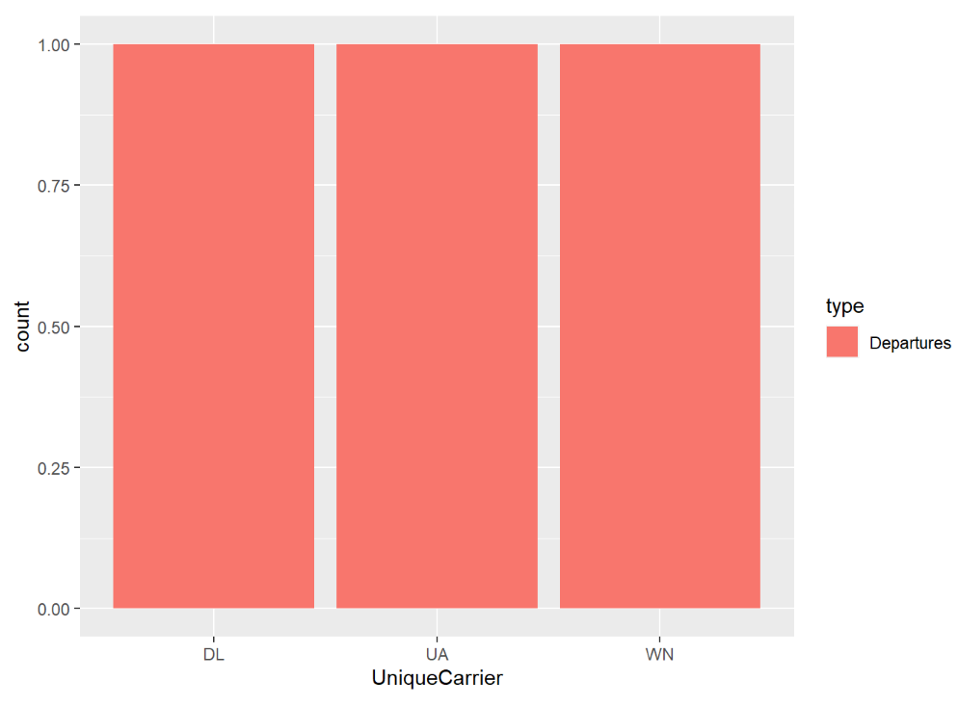
Bar chart for the largest delay for the Carriers.

Slide 24
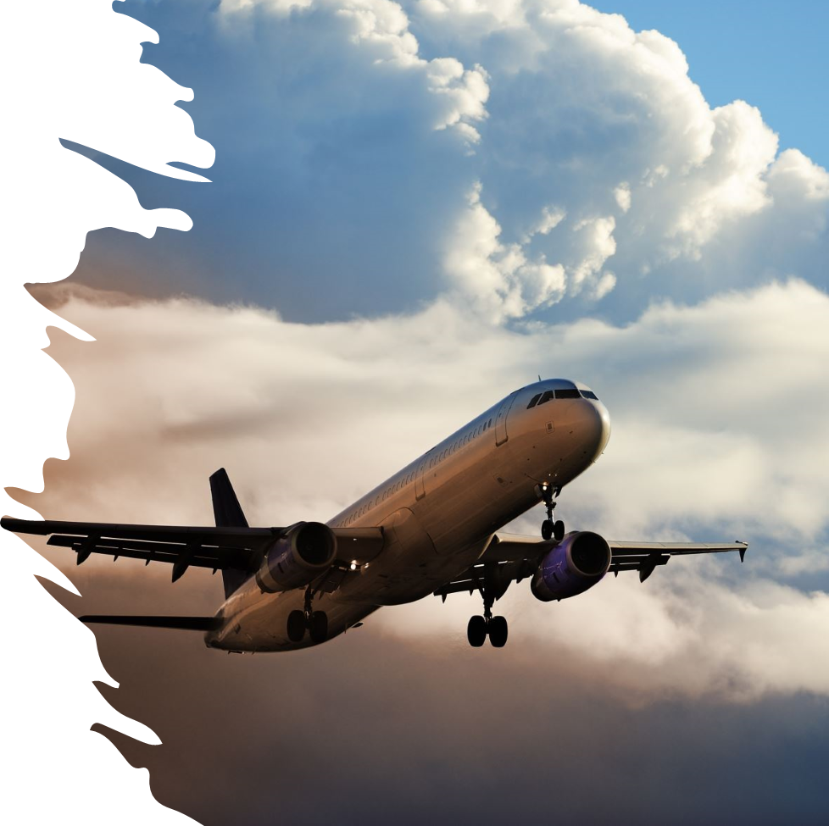
Year 2000
Presented By
Mahesh Kate

Slide 25
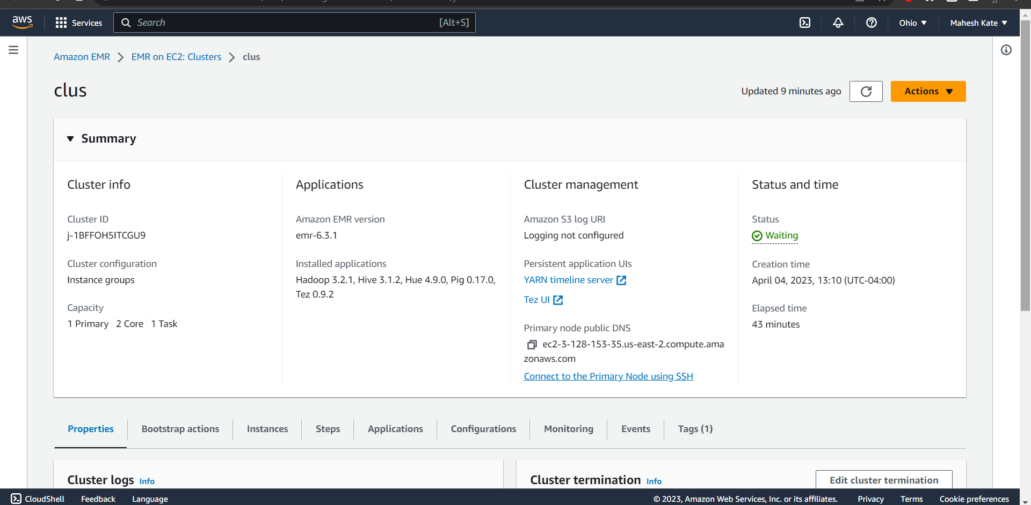
AWS Cluster

Slide 26

Putty EMR Hadoop

Slide 27
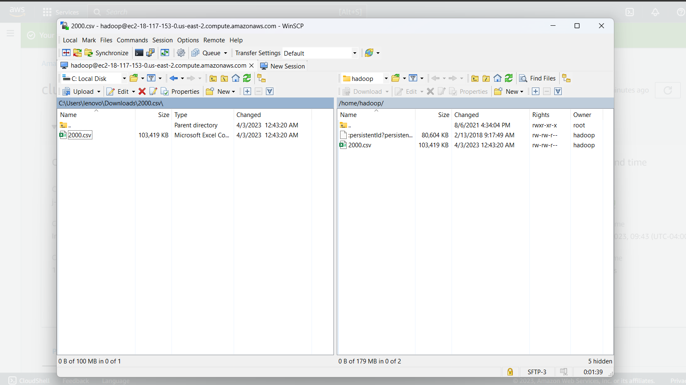
Data loading using WinSCP

Slide 28

Table creation and data loading

Slide 29
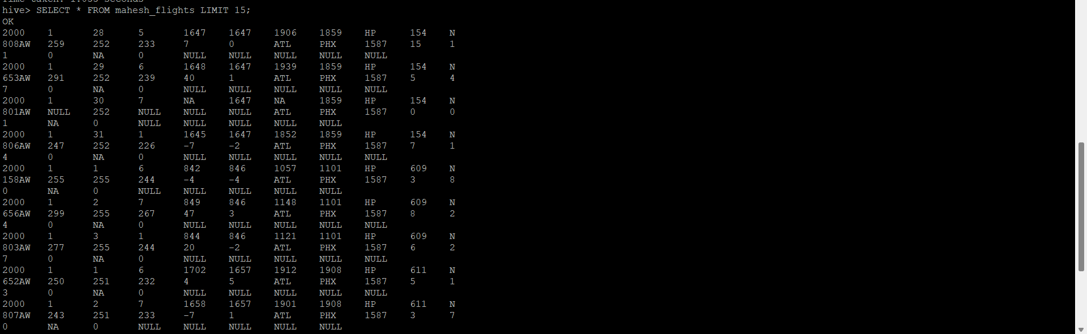
Sample of the loaded rows

Slide 30
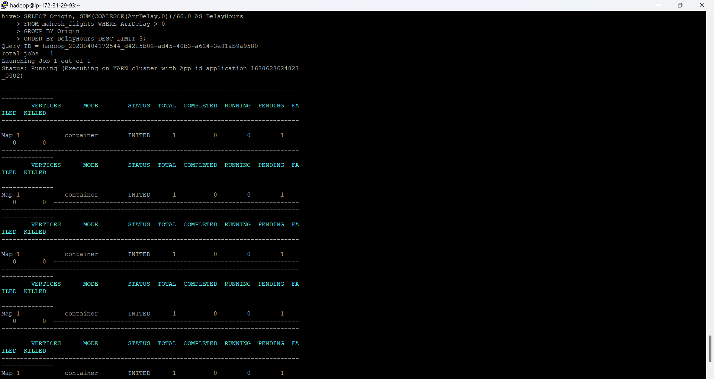
Three airports with the highest delay time

Slide 31
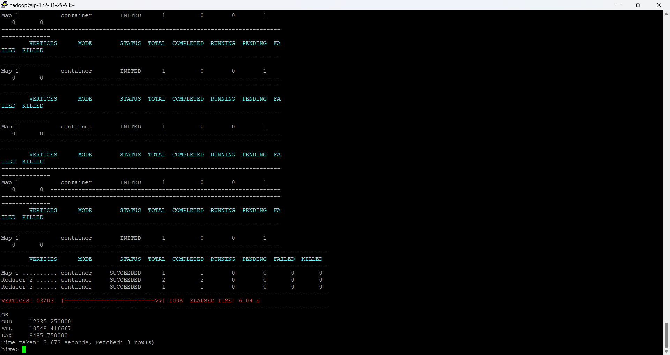

Slide 32
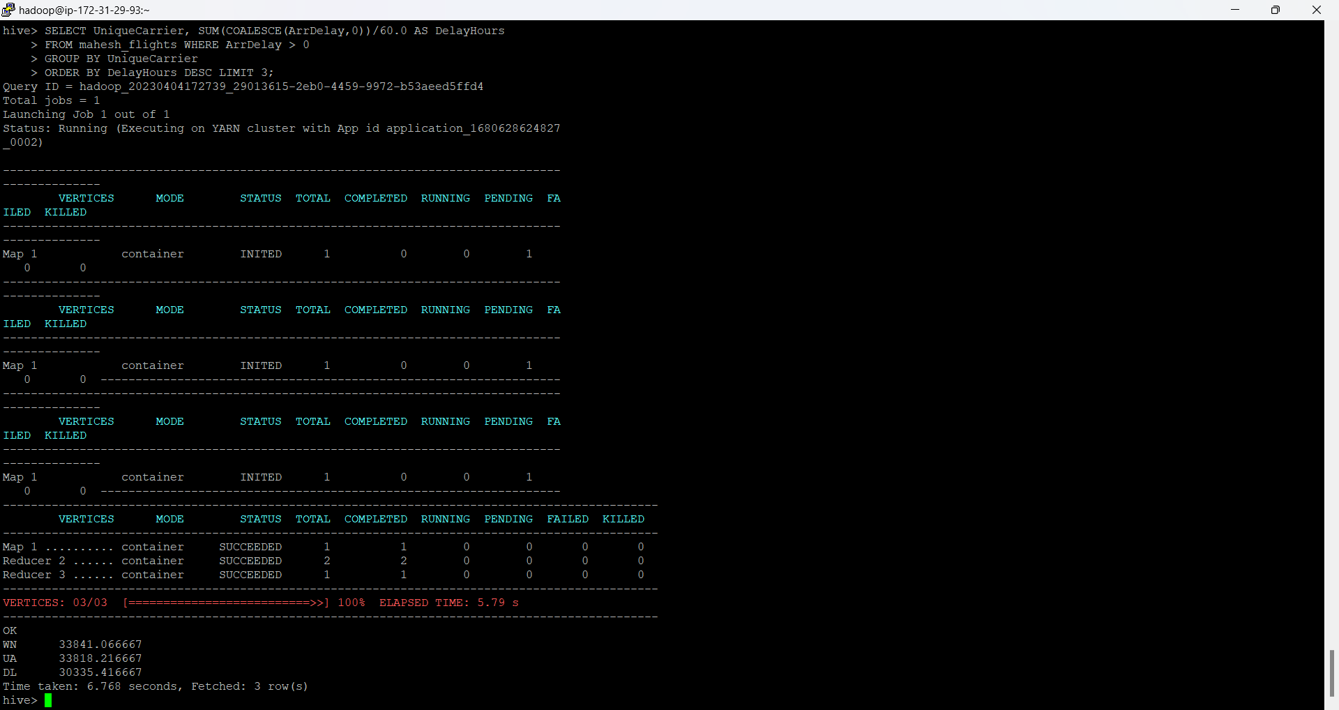
Three carriers with the highest delay time

Slide 33
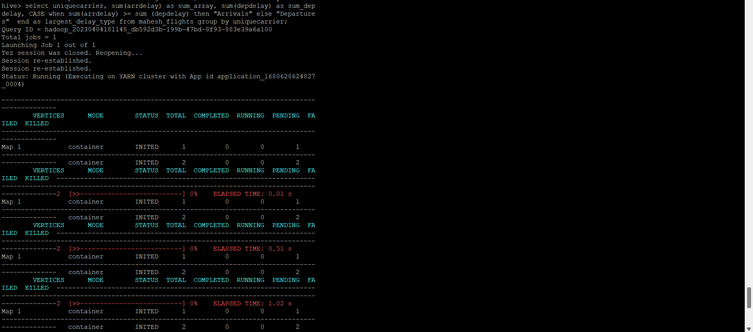
Largest delay type for the carriers

Slide 34
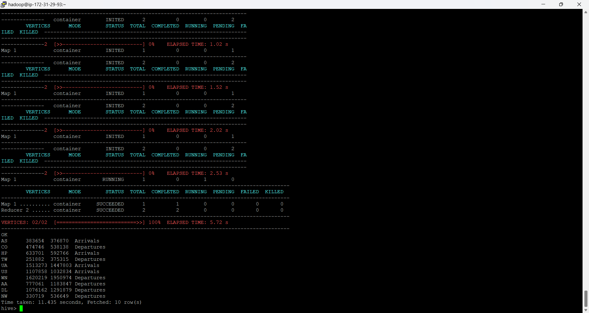
Carriers experience the greatest number of Departure delays.

Slide 35
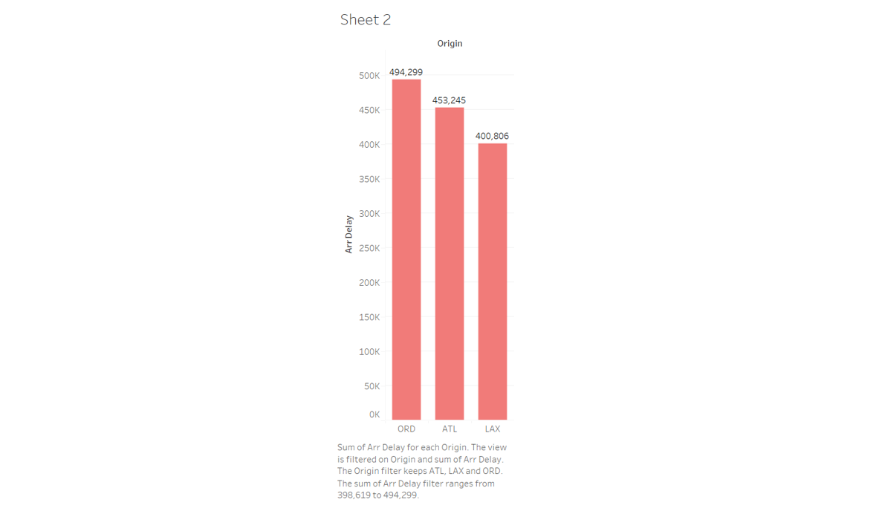
Data visualization of above numeric findings

Slide 36
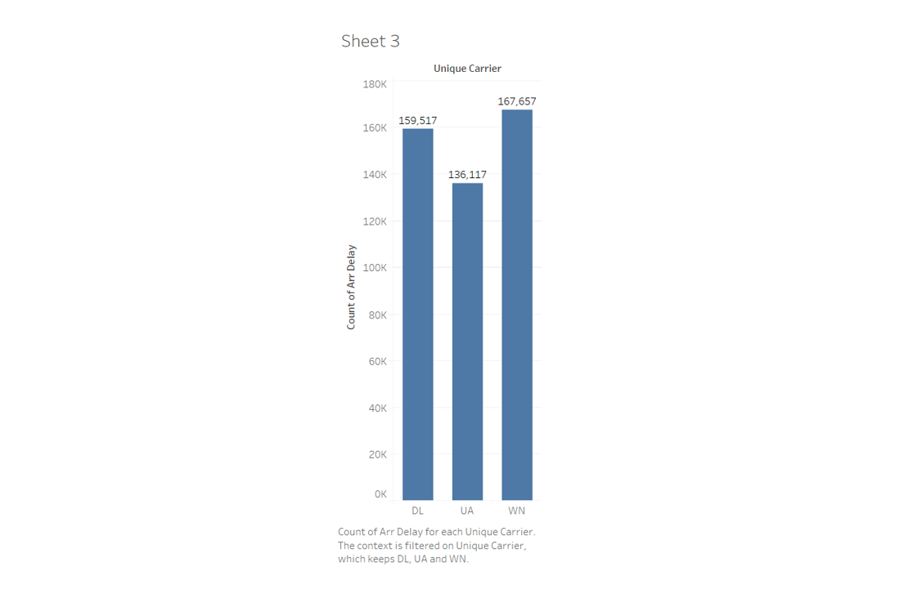

Slide 37
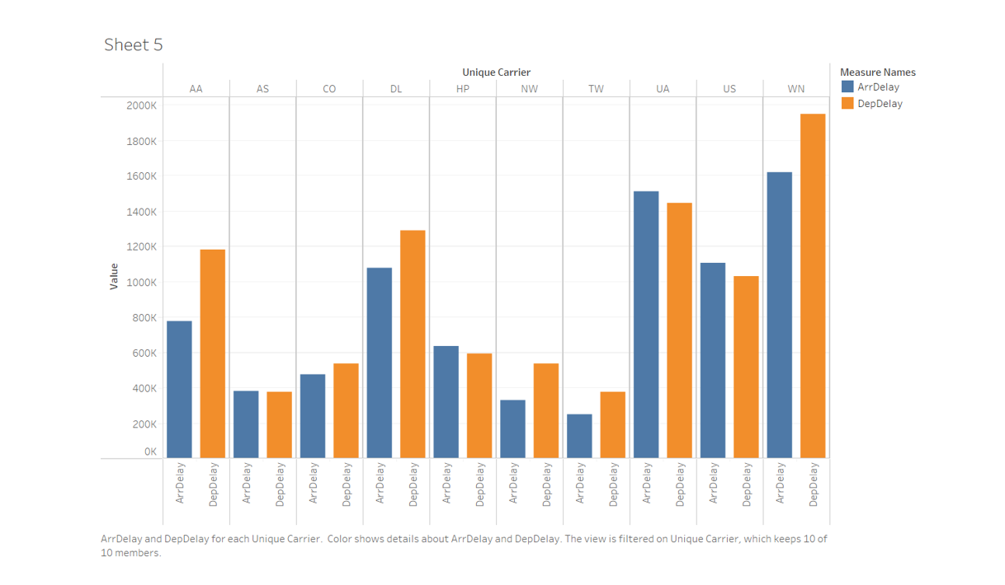

Slide 38
Year:
2003
Presented By:
Karan Gaikwad

Slide 39
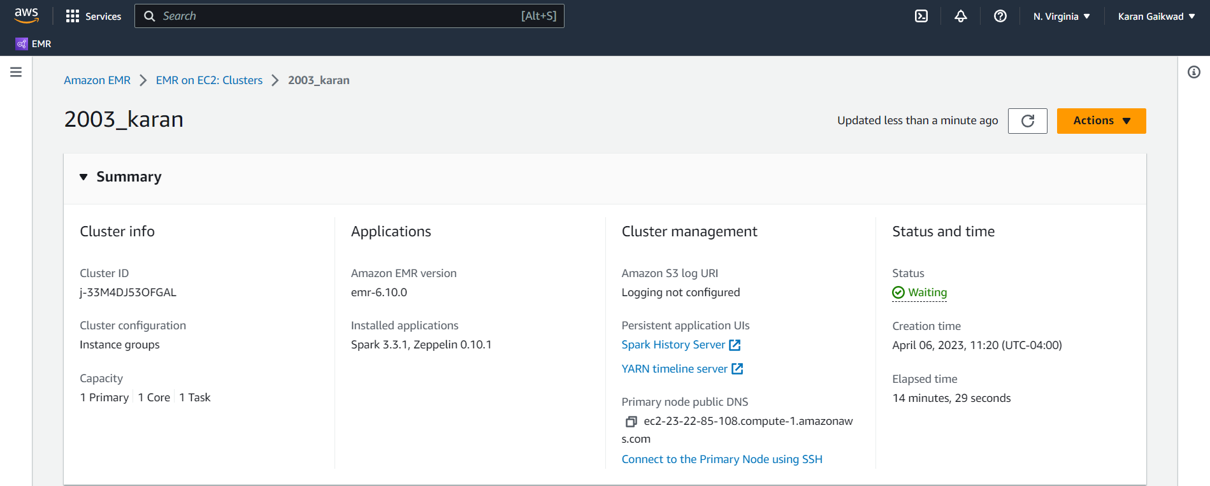
AWS Cluster Summary

Slide 40
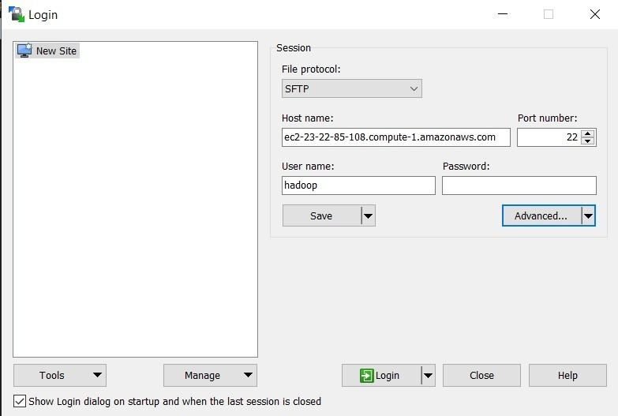
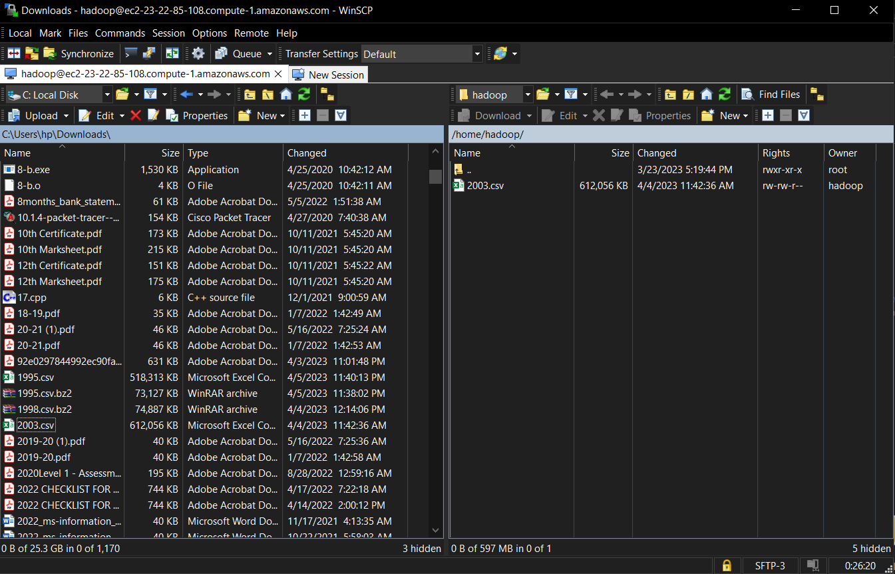
Connecting to WinSCP
Data Loading using WinSCP

Slide 41
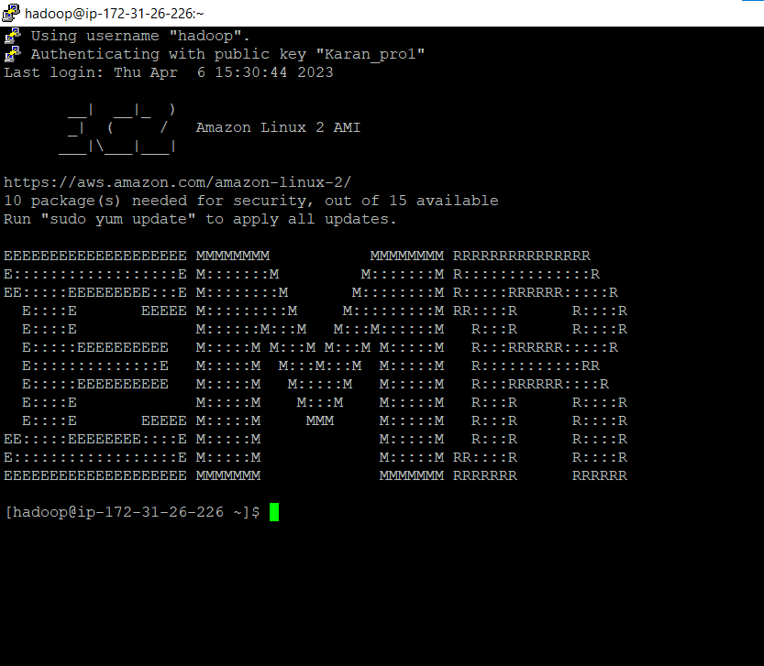
Hadoop Connection using Putty

Slide 42
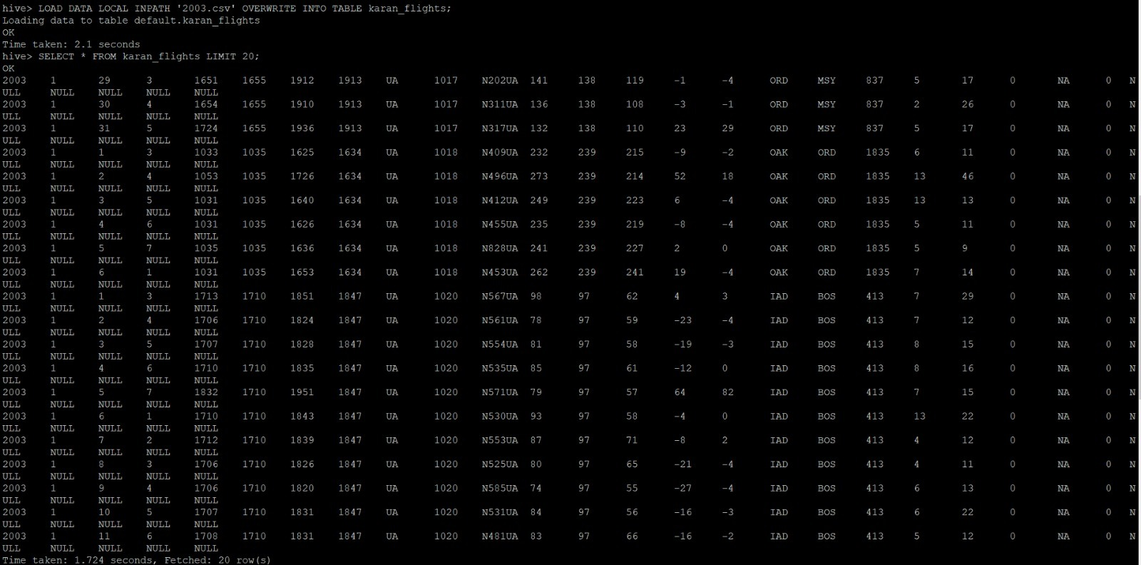
Loaded Data

Slide 43
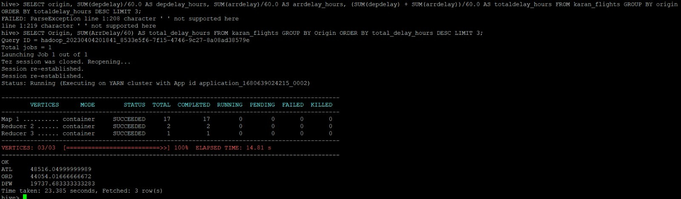
Case 1: Determine the three airports with the highest delay time (in hours).
The three airports with the highest delay time are:
Atlanta Airport (ATL)
Chicago O’Hare International Airport (ORD)
Dallas Fort Worth International Airport (DFW)

Slide 44
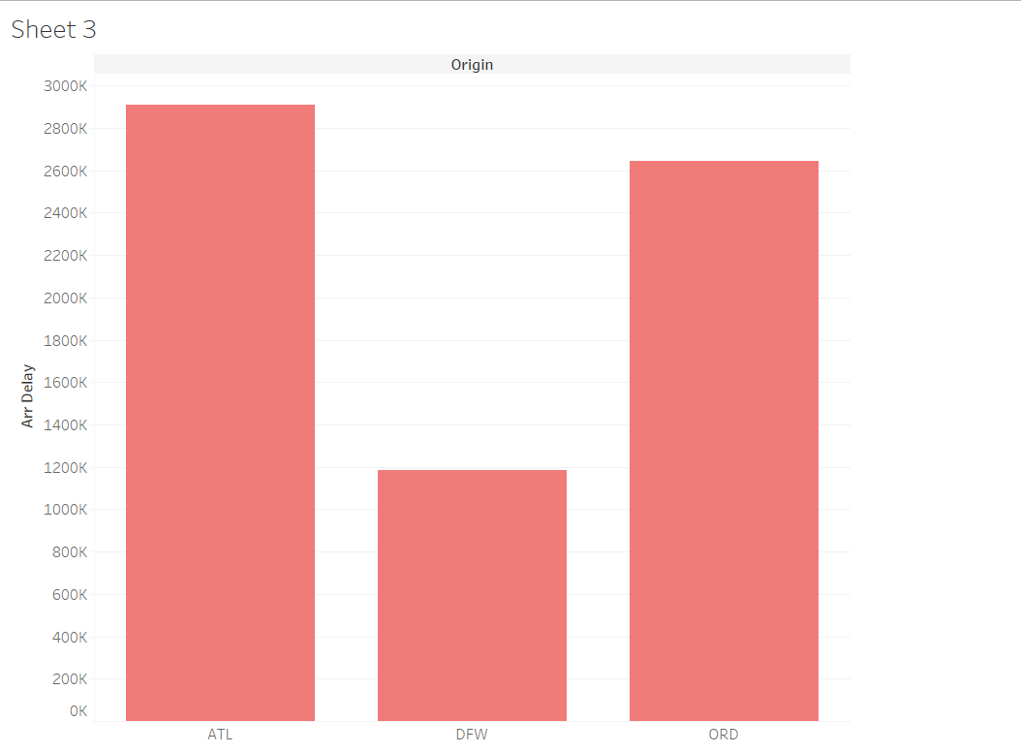
Visualization showing three airports with the highest delay time

Slide 45
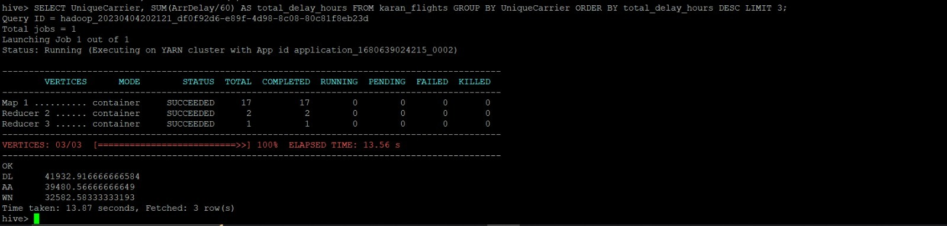
Case 2: Determine the three carriers with the highest delay time (in hours).
The three carriers with the highest delay time are:
Delta (DL)
American Airlines (AA)
Southwest Airlines (WN)

Slide 46
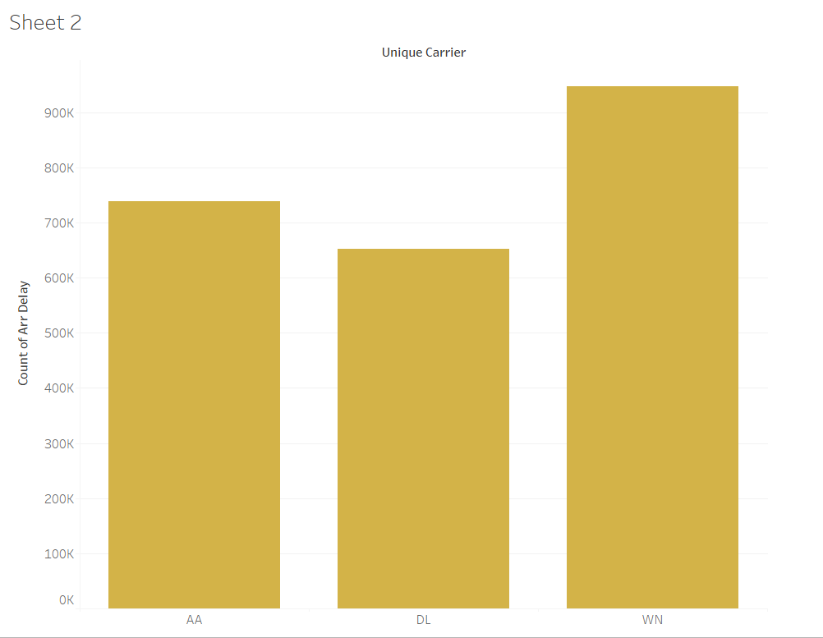
Visualization for three carriers with the highest delay time

Slide 47
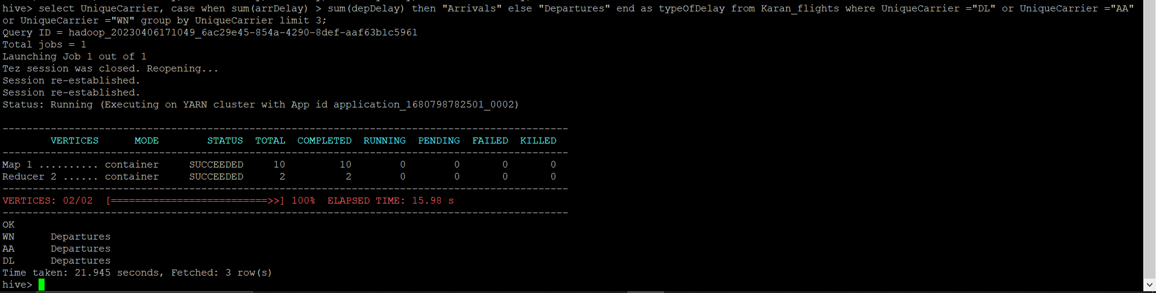
Case 3: Determine overall which type of delay (arrivals or departures) is the largest for your carriers.
All three carriers i.e.
Atlanta Airport (ATL), Chicago O’Hare International Airport (ORD), and Dallas-Fort Worth International Airport (DFW) have more ‘DEPARTURE’ delays.

Slide 48
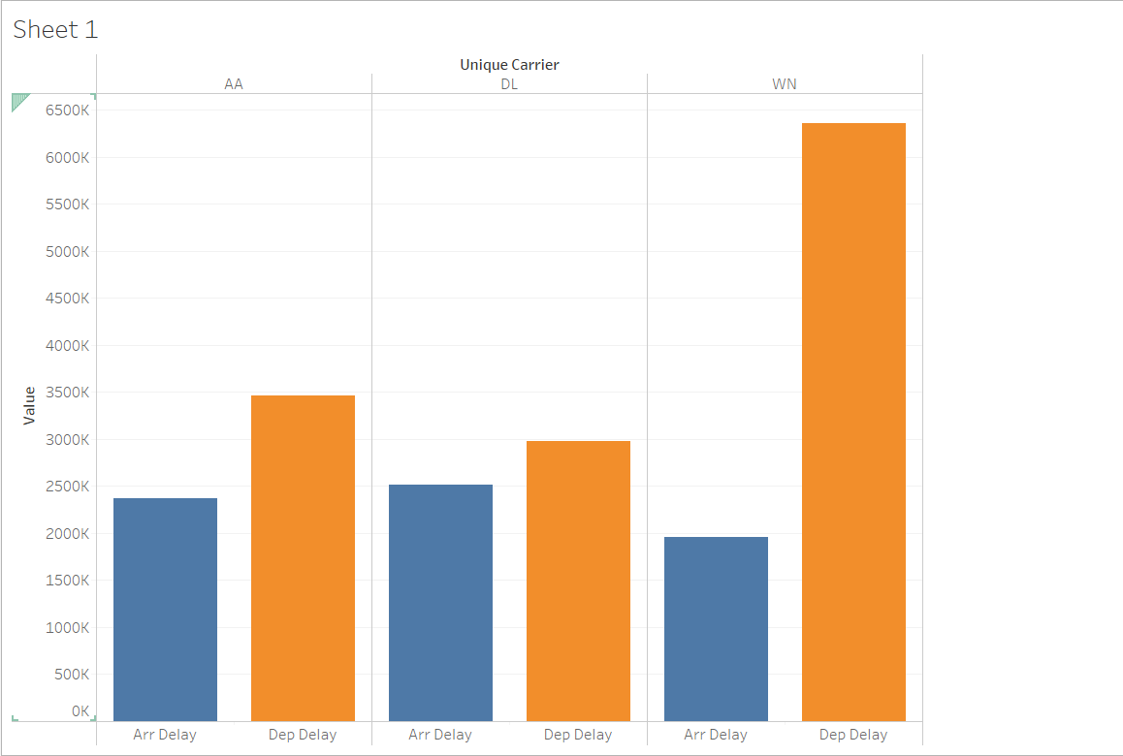
Visualization showing arrival and departure delays for the three carriers with the highest delay time

Slide 49
2008
Presented By
Dipen Patel

Slide 50
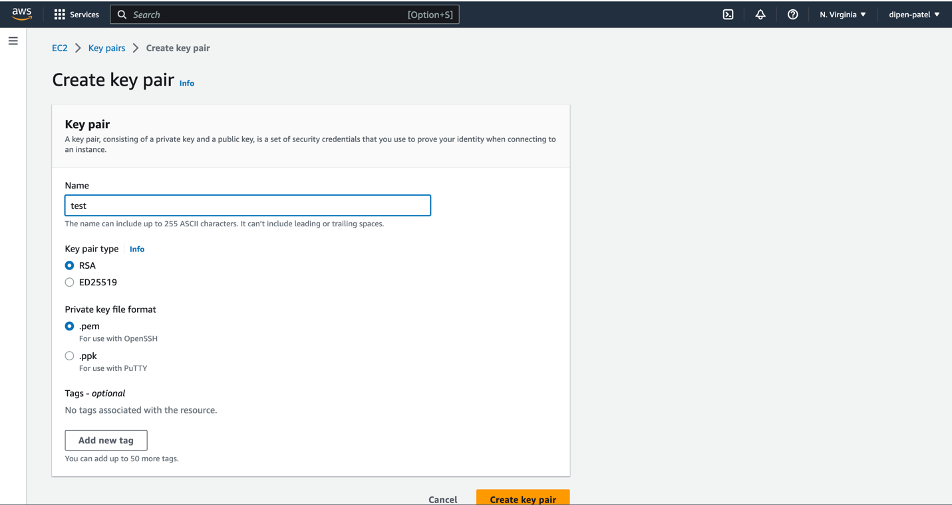
Key-Pair

Slide 51
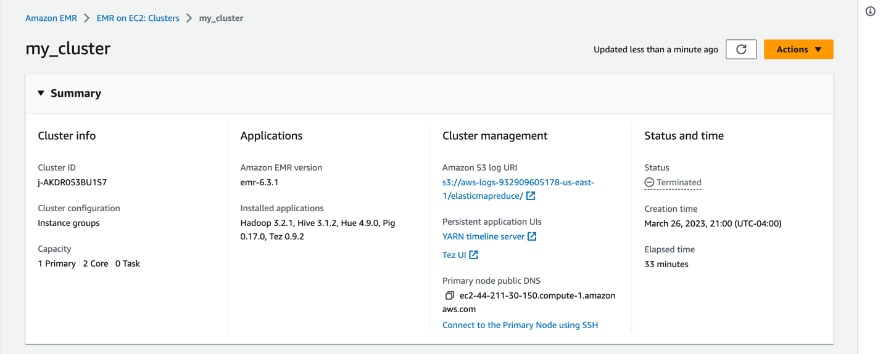
Cluster

Slide 52

EMR Hadoop

Slide 53
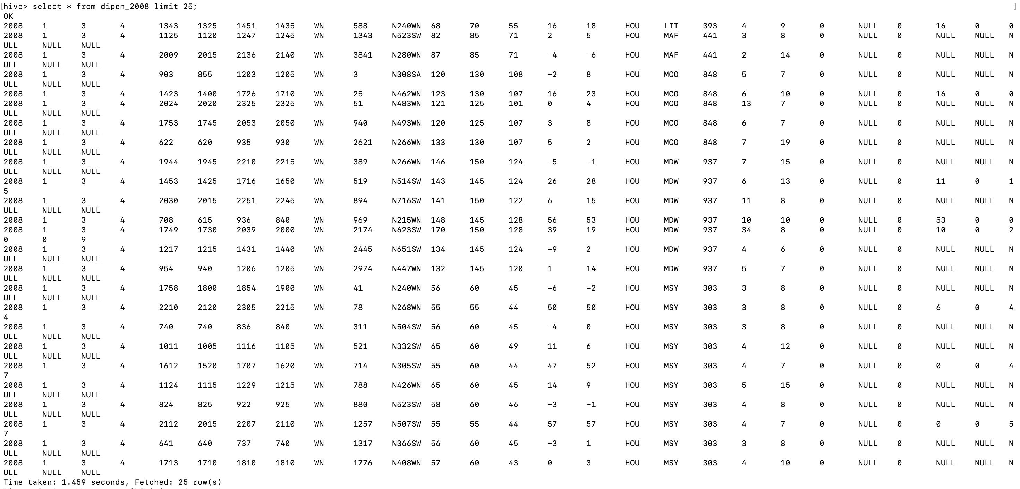
Data of Year 2008
select * from dipen_2008 limit 25;
Shows First 25 rows

Slide 54
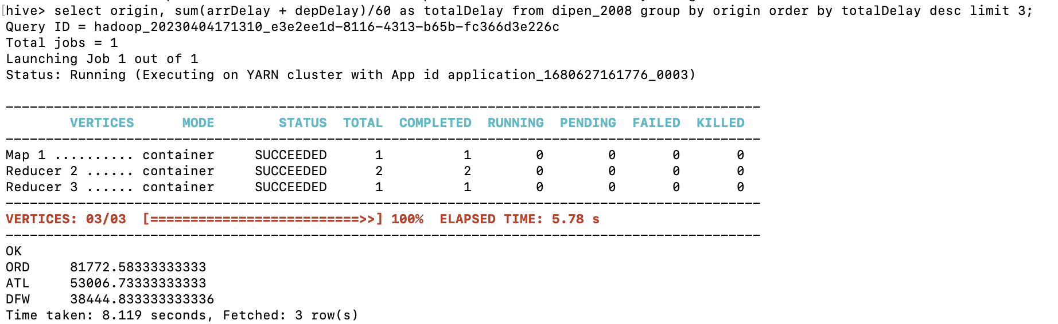
Airports with highest delay time
select origin, sum(arrDelay + depDelay)/60 as totalDelay from dipen_2008 group by origin order by totalDelay desc limit 3;
Chicago O'Hare International Airport (ORD), Chicago, Illinois, USA
William B Hartsfield-Atlanta International Airport (ATL), Atlanta, Georgia, USA
Dallas-Fort Worth International Airport (DFW), Texas, USA

Slide 55
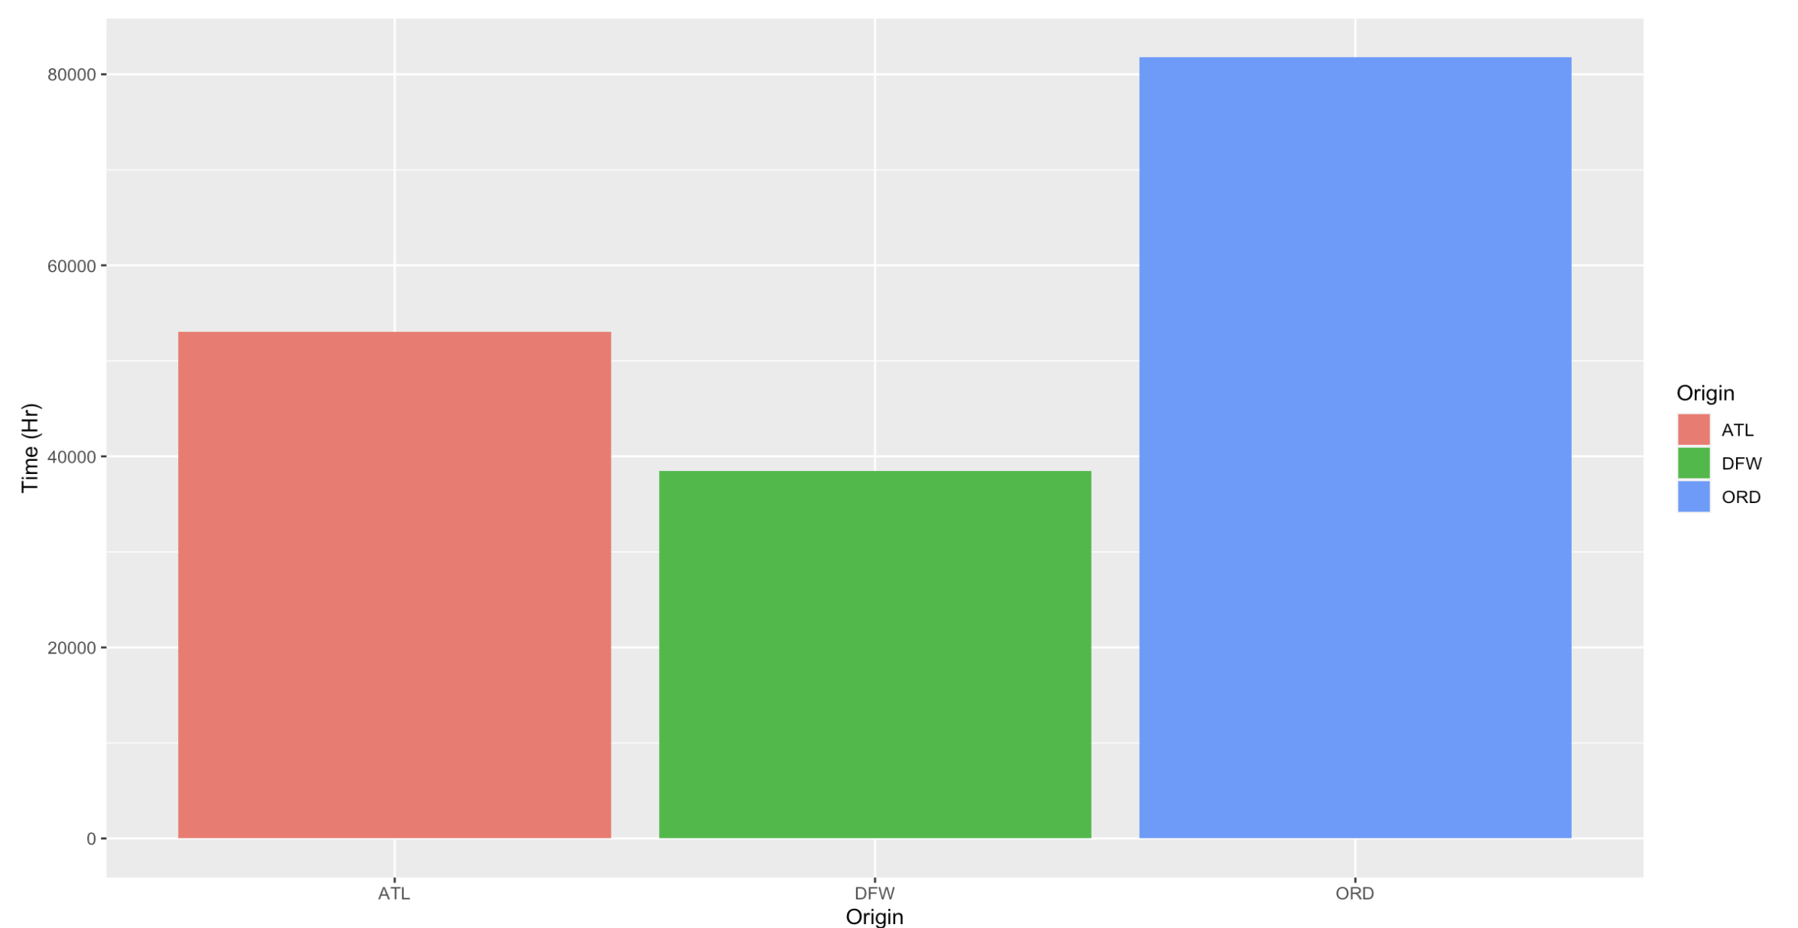
Bar Chart

Slide 56
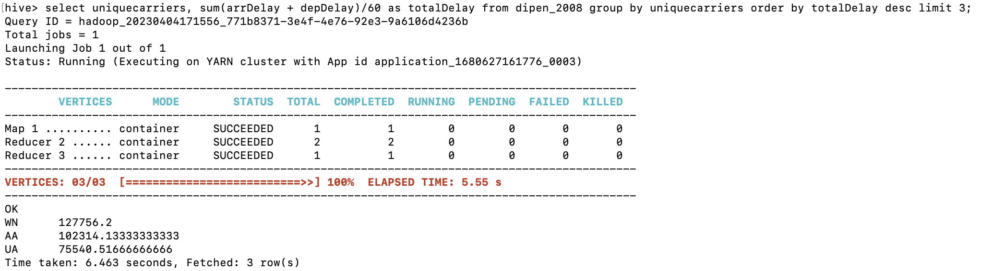
Carrier with highest delay time
select uniquecarriers, sum(arrDelay + depDelay)/60 as totalDelay from dipen_2008 group by uniquecarriers order by totalDelay desc limit 3;
1. Southwest Airlines
2. American Airlines
3. United Airlines

Slide 57
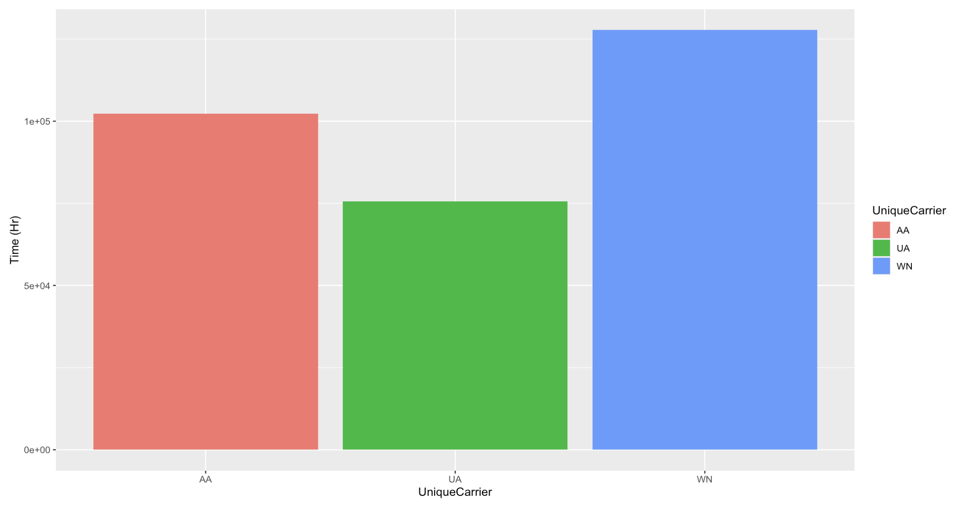
Bar Chart

Slide 58

Type of delay
select uniquecarriers, case when sum(arrDelay) > sum(depDelay) then "Arrivals" else "Departures" end as typeOfDelay from dipen_2008 where uniquecarriers ="WN" or uniquecarriers ="UA" or uniquecarriers ="AA" group by uniquecarriers limit 3 ;
American Airlines has more arrivals delay.
United Airlines and Southwest Airlines have more departure delay.

Slide 59

Bar Chart

Slide 60
Summary
Chicago and Atlanta airports have highest delay time in above mentioned five years.
Southwest airlines, United airlines, Delta airlines, and American airlines have highest delay time.
Most common type of delay is departure delay for these airlines.

